Slide 1
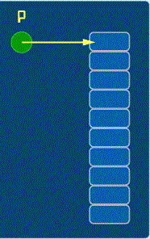
Pointers to arrays
L33-L34

Slide 2
Objectives
To learn and appreciate the following concept
Basic operations on pointers
Pointers to arrays

Slide 3
Session outcome
At the end of session one will be able to understand
Basic operations on pointers and pointers to arrays

Slide 4
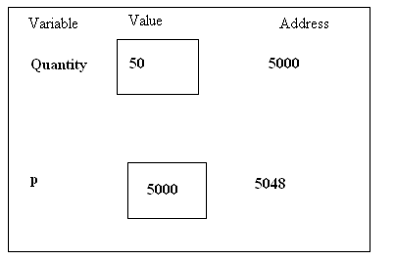
Pointers- recap
int Quantity; //defines variable Quantity of type int
int* p; //defines p as a pointer to int
p = &Quantity; //assigns address of Quantity to pointer p
Now…
Quantity = 50;//assigns 50 to Quantity
*p = 50; //assigns 50 to Quantity

Slide 5
Pointer expressions
Pointers can be used in most valid C++ expressions. However, some special rules apply.
You may need to surround some parts of a pointer expression with parentheses in order to ensure that the outcome is what you desire.
As with any variable, a pointer may be used on the right side of an assignment operator to assign its value to another pointer.
Notes:
Pointers can be used in most valid C++ expressions. However, some special rules apply.
You may need to surround some parts of a pointer expression with parentheses in order to ensure that the outcome is what you desire.
As with any variable, a pointer may be used on the right side of an assignment operator to assign its value to another pointer.

Slide 6
Pointer Expressions - Example
Eg: int a=10, b=20,c,d=10;
int *p1 = &a, *p2 = &b;
Expression | a | b | c
c= *p1**p2 OR *p1 * *p2 OR (*p1) * (*p2) | 10 | 20 | 200
c= c + *p1; | 10 | 20 | 210
c=5 * - *p2 / *p1; OR ( 5 * (- (*p2)))/(*p1) //space between / and * (?) | 10 | 20 | -10
*p2 =*p2 +10; | 10 | 30
Notes:
Like other variables, contents of pointer variables can be used in expressions. This slide gives example for expressions involving pointers. In these expressions, the value contained at the location pointed by pointer is used and NOT the value of pointer. Thus instead of the actual variable, we can use the pointer variable it is pointed by.
The space between / and * in 3rd expression is required ; otherwise it will be treated as a comment (/*)

Slide 7
Operations on Pointer Variables
Assignment – the value of one pointer variable can be assigned to another pointer variable of the same type
Relational operations - two pointer variables of the same type can be compared for equality, and so on
Some limited arithmetic operations
integer values can be added to and subtracted from a pointer variable
value of one pointer variable can be subtracted from another pointer variable
Shorthand Increment and Decrement Operators
Notes:
Some limited arithmetic operations
integer values can be added to and subtracted from a pointer variable
value of one pointer variable can be subtracted from another pointer variable
Increment/Decrement operations
Note: If p1 and p2 are both pointers to the same array, then p2-p1 gives the number of elements between p1 and p2.

Slide 8
Pointer Operations - Example
int a = 10, b = 20,*p1,*p2,*p3,*p4;
p1 = &a; //assume address of a = 2004
p2 = &b; //assume address of b = 1008
Assume an integer occupies 4 bytes
Pointer Operations | Example expression | Result
Addition of integers from pointers | p3 = p1 + 2 | value of p3 = 2004 + 4*2 = 2012
Subtraction of integers from pointers | p4 = p2 – 2 | value of p4 = 1008-4*2 = 1000
Subtraction of one pointer from another | c = p3– p1 | Value of c = 2012– 2004= 2
Pointer Increment | p1++ | Value of p1 = 2008
Pointer Decrement | --p1 | Value of p1 = 2004
Notes:
As we've seen, you can add an integer to a pointer to get a new pointer, pointing somewhere beyond the original . For example, you might write
ip2 = ip1 + 3;
Applying a little algebra, you might wonder whether ip2 - ip1 = 3 and the answer is, yes. When you subtract two pointers, as long as they point to the same type, the result is the number of elements separating them.

Slide 9
Pointer Operations - Example
if (p1<p2)
cout<<“p1 points to lower memory than p2”;
if (p1==p2)
cout<<“p1 and p2 points to same location”;
if (p1!=p2)
cout<<“p1 and p2 NOT pointing to same location”;
Notes:
Relational operations - two pointer variables of the same type can be compared for equality, and so on

Slide 10
Invalid Operations:
Pointers are not used in division and multiplication.
p1/*p2;
p1*p2;
p1/3; are not allowed.
Two pointers can not be added.
p1 + p2 is illegal.
Notes:
The following are not allowed in C.
Add two pointers.
p1 = p1 + p2;
Multiply / divide a pointer in an expression.
p1 = p2 / 5;
p1 = p1 - p2 * 10;

Slide 11
Pointers and arrays
When an array is declared, the compiler allocates a base address and sufficient amount of storage to contain all the elements of the array in contiguous memory locations.
The base address is the location of the first element (index 0) of the array.
The compiler also defines the array name as a constant pointer to the first element.
Notes:
For example, consider a block in memory consisting if ten integers in a row. That is, 40 bytes of memory are set aside to hold 10 integers.
Now, let's say we point our integer pointer ptr at the first of these integers. Furthermore lets say that integer is located at memory location 100 (decimal).
What happens when we write: ptr + 1; Because the compiler "knows" this is a pointer (i.e. its value is an address) and that it points to an integer (its current address, 100, is the address of an integer), it adds 4 to ptr instead of 1, so the pointer "points to" the next integer, at memory location 104. Similarly, were the ptr declared as a pointer to a short, it would add 2 to it instead of 1. The same goes for other data types such as floats, doubles, or even user defined data types such as structures. We refer to this addition as "pointer arithmetic“.
Similarly, since ++ptr and ptr++ are both equivalent to ptr + 1 (though the point in the program when ptr is incremented may be different), incrementing a pointer using the unary ++ operator, either pre- or post-, increments the address it stores by the amount sizeof(type) where "type" is the type of the object pointed to. (i.e. 4 for an integer).
Since a block of 10 integers located contiguously in memory is, by definition, an array of integers, this brings up an interesting relationship between arrays and pointers.

Slide 12
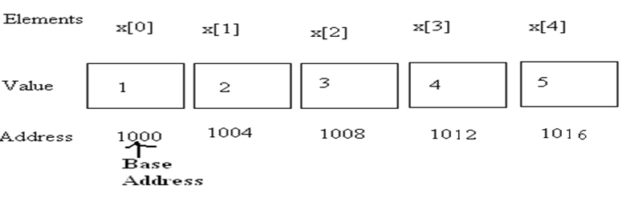
Pointers and arrays
An array x is declared as follows and assume the base address of x is 1000.
int x[5] ={ 1,2,3,4,5};
Array name x, is a constant pointer, pointing to the first element x[0] .
Value of x is 1000 (Base Address), the location of x[0] .
i.e. is x = &x[0] = 1000 (in the example)
Notes:
Consider the following:
int my_array[] = {1,23,17,4,-5,100};
Here we have an array containing 6 integers. We refer to each of these integers by means of a subscript to my_array, i.e. using my_array[0] through my_array[5]. But, we could alternatively access them via a pointer as follows:
int *ptr; ptr = &my_array[0]; /* point our pointer at the first integer in our array */

Slide 13
Array accessing using Pointers
An integer pointer variable p, can be made to point to an array as follows:
int x[5] ={ 1,2,3,4,5};
int *p;
p = x; OR p = &x[0];
Following statement is Invalid:
p = &x ; //Invalid
Successive array elements can be accessed by writing:
cout<<*p; p++;
or cout<<*(p+i); i++;
Notes:
The name x is defined as a constant pointer pointing to the first element, x[0] and therefore the value of x is 1000, the location where x[0] is stored.
i.e. is x =&x[0] →1000;
If we declare p as an integer pointer, then we can make the pointer p point to the array x by the following statement:
p=x; OR p=&x[0];
The following statement is invalid as value of x is 1000 (base address) and then we are applying address of operator on a constant:
p=&x;

Slide 14
Pointers and arrays
The relationship between p and x is shown below:
p= &x[0]; (=1000) BASE ADDRESS
p+1=>&x[1] (=1004)
p+2=>&x[2] (=1008)
p+3=>&x[3] (=1012)
p+4=>&x[4] (=1016)
Address of an element of x is given by:
Address of x[i] = base address + i * scale factor of (int)
Address of x[3]= 1000 +(3*4) = 1012

Slide 15
Array accessing using array name as pointer - Example
void main( )
{
int arr[5] = { 31, 54, 77, 52, 93 };
for(int j=0; j<5; j++) //for each element,
cout << *(arr+j); //print value
}
“arr” itself is a constant pointer which can be used to access the elements.
Output:
31
54
77
52
93
Notes:
Array name is a constant pointer. We can access the array elements by adding the index value to array name. Since array name is constant pointer, we cannot apply increment/decrement operator on it.(arr++).

Slide 16
Array accessing using Pointers - Example
// array accessed with pointer
void main() {
int arr[] = { 31, 54, 77, 52, 93 };
int* ptr; //pointer to arr
ptr = arr; //points to arr
for(int j=0; j<5; j++) //for each element,
cout << *ptr++; //print value
}
“ptr” is a pointer which can be used to access the elements.
Output:
31
54
77
52
93

Slide 17
Summary
Do’s
Don’ts
Applications
Case studies
Do it yourself
MCQ
Basic operations on pointers
Pointers to array

